Slide 1
HTML

Slide 2
Introduction to HTML
HTML Document Structure:
Understanding the basic structure of an HTML document.
HTML document anatomy (DOCTYPE declaration, <html>, <head>, <body>).
HTML Elements:
Introduction to HTML elements.
Commonly used elements (e.g., <p>, <h1>, <a>, <img>).
HTML Attributes:
Understanding attributes and their role.
Common attributes (e.g., src, href, alt, class, id).
Headings and Paragraphs:
Proper usage of heading tags (<h1> to <h6>).
Creating paragraphs with the <p> tag.
Lists:
Creating unordered lists (<ul> and <li>).
Creating ordered lists (<ol> and <li>).

Slide 3
Introduction to HTML
Links and Navigation:
Creating hyperlinks with the <a> tag.
Understanding relative and absolute URLs.
Images:
Embedding images with the <img> tag.
Using the alt attribute for accessibility.
Forms and Input Elements:
Creating basic forms with the <form> tag.
Common input types (<input> for text, password, radio buttons, checkboxes).
Semantic HTML:
Introduction to semantic HTML.
Using semantic tags like <header>, <nav>, <article>, <section>, <footer>.
HTML Validation:
The importance of valid HTML.
Using online validators to check HTML code.
Responsive Design:
Basics of responsive web design.
Using viewport meta tag (<meta name="viewport" content="width=device-width, initial-scale=1.0">).

Slide 4
HTML Versions
In the early 2000s, web standards organizations like the World Wide Web Consortium (W3C), founded in 1994 by Sir Tim Berners, played a critical role in shaping the future of HTML. They worked on developing the next version, which would be known as HTML5.
HTML5 (2014):
HTML5 is the latest and widely adopted version, and it continues to be the standard for web development.
A major revision that introduced numerous new features.
Improved support for multimedia elements (audio and video).
Introduced new semantic elements like <article>, <section>, <nav>, and <header>.
Enhanced form elements, including new input types.
Native support for offline web applications.
Introduced the <canvas> element for drawing graphics.
Integrated and enhanced support for JavaScript and APIs.

Slide 5
HTML Document Structure

Slide 6
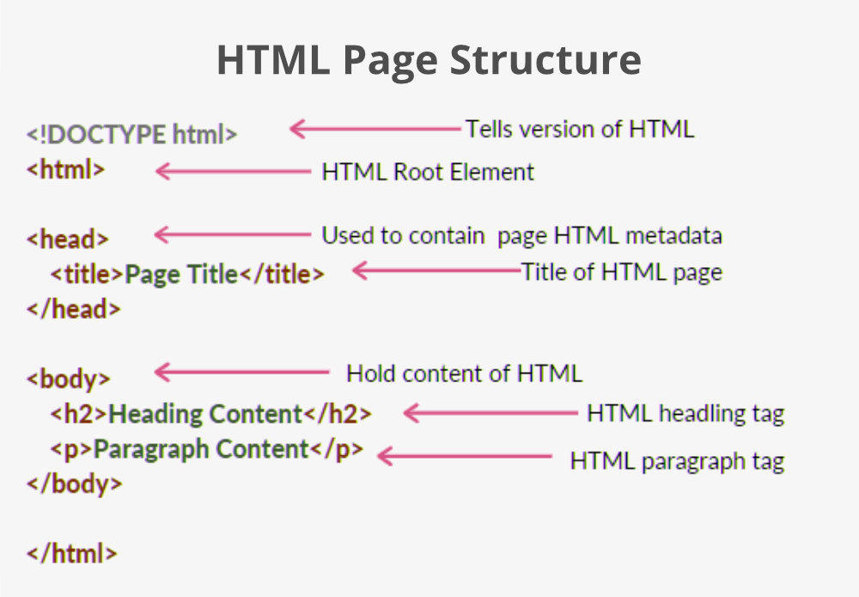

Slide 7
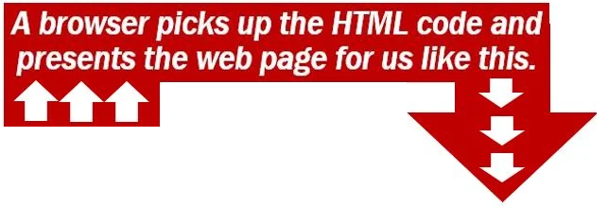
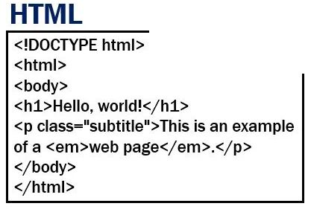
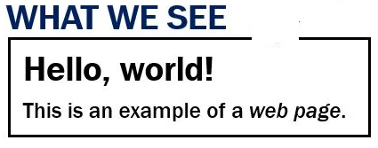

Slide 8
HTML Document Structure
HTML is a markup language, consist on a set of markup tags to describe web page. HTML markup tags are usually called HTML tags, surrounded by angle brackets like <html>
<!DOCTYPE html>
<html>
<head>
<title>Your Page Title</title>
</head>
<body>
<h1>Welcome to Our School!</h1>
<p>We are thrilled to have you join us on this exciting educational journey.</p>
</body>
</html>
HTML tags normally comes in pairs like <b> and </b>. The first tag in a pair is the start tag, the second tag is the end tag. Start and end tags are also called opening tags and closing tags. The closing tag has a forward slash ("/") before the tag name.

Slide 9
HTML Document Structure
HTML Document basic structure consist on
<!DOCTYPE html> specifies the HTML version.
<html> is the root element that encloses the entire HTML document.
<head> contains meta-information about the page, including the title shown in the browser tab.
<body> holds the visible content of your web page.

Slide 10
<!DOCTYPE html>
HTML Doctype Declaration specifies the version of HTML in which a web page is written. It was firstly introduced with HTML5 and informs the web browser about the document type and version, helping it to render the page correctly.
<!DOCTYPE>: This is the document type declaration (DTD). It is not an HTML tag but rather an instruction to the browser about the version and type of document.
html: This specifies the root element of the document. In this case, it indicates that the document is an HTML document. Other possible types XHTML, XML, SVG, MathML, etc.
If you do not include the <!DOCTYPE html> declaration in your HTML document, with several things, your browser can create issues related CSS styling, version, page rendering.

Slide 11
HTML Root Element
<html></html>
The <html> tag is the root element that encapsulates all the content on the page. In <html > tag we use “lang” attributes to define languages of html page such as <html lang=”en”> here en represents English language.
Head:- This tag contains the metadata and other information about the HTML document. For Example,
<meta charset="UTF-8">
<meta name="viewport" content="width=device-width, initial-scale=1.0">
<meta name="description" content="A brief description of your page.">
<meta name="keywords" content="HTML, CSS, JavaScript">
<script src="script.js" defer></script>
<link rel="icon" href="favicon.ico" type="image/x-icon">
<link rel="stylesheet" href="styles.css">
BODY: This tag contains everything you want to display on the Web Page.

Slide 12
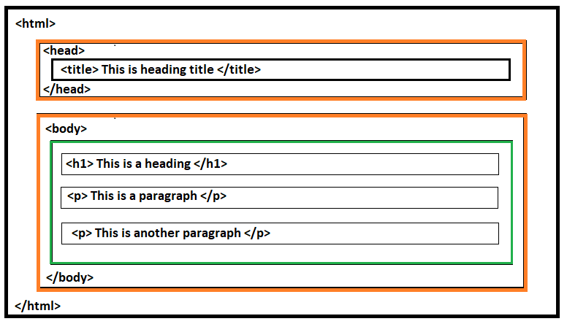

Slide 13
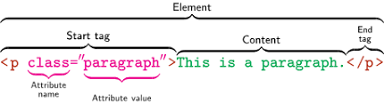
HTML Elements
Source - Wikipedia

Slide 14
HTML Elements
HTML tags are the building blocks of a web page. Tags can be describe as
Elements:- HTML element is the collection of start tag, its attributes, an end tag and everything in between.
Example:- Element = “<h1>Hello World!</h1>”
An element can be consist of
Attributes:- Attributes provide additional information about HTML elements, included in the opening tag and are used to modify the element's behavior or appearance. It consist of two parts: the name and the value.
Name: Specifies the property for that element.
Value: Sets the value of that property for the element

Slide 15
Elements General Attributes
There are four main types of attributes
ID attribute:- The ID attribute is used to assign a unique identifier to an HTML element. <p id="python">This is a Python tutorial</p>
Class attribute:- The class attribute is used to associate an HTML element with a particular class, typically for styling or JavaScript manipulation. Unlike the ID attribute, the class attribute is not unique, and multiple elements can share the same class. <p class="myClass">This is a paragraph with the same class.</p>
Title attribute:- The title attribute provides additional information about an element and is often displayed as a tooltip when the mouse hovers over it. <h4 title="hello, motto">Title attribute</h4>
Style attribute:- The style attribute allows for inline styling of HTML elements. It is used in conjunction with CSS properties to directly style individual elements within the HTML code.
Note:- HTML attributes names can be written in uppercase or lowercase (recomended)

Slide 16
Element Special Attributes
The href Attribute:-
The <a> tag defines a hyperlink. The href attribute specifies the URL of the page the link goes to:
<a href="https://www.w3schools.com">Visit W3Schools</a>
<link href="https://www.w3schools.com">Visit W3Schools</href>
<a> is for clickable links, while <link> is for linking resources like stylesheets
The src Attribute:-
The <img> tag is used to embed an image in an HTML page. The src attribute specifies the path to the image to be displayed:
<img src="https://www.w3schools.com/images/img_girl.jpg".>
The <img> tag should also contain the width and height attributes,
<img src="img_girl.jpg" width="500" height="600">
The required alt attribute for the <img> tag specifies an alternate text for an image,
<img src="img_girl.jpg" alt="Girl with a jacket">

Slide 17
Conti..
The width, height, and style attributes are all valid in HTML. However, we suggest using the style attribute. It prevents styles sheets from changing the size of images:
<img src="html5.gif" alt="HTML5 Icon" width="128" height="128"> Or <img src="html5.gif" alt="HTML5 Icon” style=“width:128px; height:128px;”>

Slide 18
Global Attributes
Global attributes in HTML can be applied to any HTML element. Here are some of the most commonly used global attributes:
class: Specifies one or more class names for styling with CSS.
id: Provides a unique identifier for the element.
style: Contains inline CSS styles for the element.
title: Offers additional information about the element, typically displayed as a tooltip.
lang: Specifies the language of the element's content (e.g., lang="en" for English).
data-*: Allows you to store custom data attributes (e.g., data-user-id="123").
hidden: A Boolean attribute that indicates that the element is not yet, or is no longer, relevant (effectively hides it).

Slide 19
HTML Tags

Slide 20
HTML Tags
HTML uses tags to define web page structure. Tags are enclosed in angle brackets, like <tagname>. Tags usually come in pairs, with an opening tag and a closing tag. The closing tag has a forward slash before the tag name, like </tagname>.
<tagname>This is an example of a tag.</tagname>

Slide 21
Text Tags
In HTML, text tags are used to structure and present text content on a webpage. Here are some basic Text Tags
<p>: Paragraph.
<h1>, <h2>, <h3>, <h4>, <h5>, <h6>: Headings.
<strong>: Strong emphasis (typically bold).
<em>: Emphasis (typically italic).
<br>: Line break.
<hr>: Horizontal Line.

Slide 22
HTML Tags
List Tags
<ul>: Unordered list.
<ol>: Ordered list.
<li>: List item.
Table Tags
<table>: Table.
<tr>: Table row.
<td>: Table data cell.
<th>: Table header cell.
<thead>: Table header group.
<tbody>: Table body group.
<tfoot>: Table footer group.
Hyperlink and Media Tags
<a>: Anchor (used for links).
<img>: Image.
<audio>: Audio content.
<video>: Video content.
Semantic Tags
<header>: Header section.
<footer>: Footer section.
<article>: Article.
<section>: Section.
<nav>: Navigation.
<aside>: Sidebar content.

Slide 23
Empty Tags (Elements)
Empty Elements:- HTML elements without a closing tag are known as empty elements like
<br> Use to break line
<hr>
<img>
<input>
<link>
<col>
<meta>

Slide 24
HTML List Tags

Slide 25


HTML Lists
HTML lists allow web developers to group a set of related items in lists. Lists can be
An unordered list starts with the <ul> tag. Each list item starts with the <li> tag.
<ul> <li>Coffee</li> <li>Tea</li> <li>Milk</li> </ul>
An ordered list starts with the <ol> tag. Each list item starts with the <li> tag.
<ol> <li>Coffee</li> <li>Tea</li> <li>Milk</li> </ol>

Slide 26
HTML Unorder-Lists Style attribute
The style attribute of list define the style & line-height of the list item maker.
list-style-type property can have the following value
<ul style="list-style-type:disc;"> <li>Coffee</li> <li>Tea</li> <li>Milk</li> </ul>
<ul style="line-height:180%"> <li>Coffee</li> <li>Tea</li> <li>Milk</li> </ul>
disc | Sets the list item marker to a bullet (default)
circle | Sets the list item marker to a circle
square | Sets the list item marker to a square
none | The list items will not be marked

Slide 27
HTML Ordered-List Type attribute
The type attribute of the <ol> tag, defines the type of the list item marker:
By default, an ordered list will start counting from 1. If you want to start counting from a specified number, you can use the start attribute: <ol start="50"> <li>Coffee</li> <li>Tea</li> <li>Milk </li> </ol>
<ol type="1"> <li>Coffee</li> <li>Tea</li> <li>Milk</li> </ol>
<ol type="A"> <li>Coffee</li> <li>Tea</li> <li>Milk</li> </ol>
<ol type="i"> <li>Coffee</li> <li>Tea</li> <li>Milk</li> </ol>
type="1" | The list items will be numbered with numbers (default)
type="A" | The list items will be numbered with uppercase letters
type="a" | The list items will be numbered with lowercase letters
type="I" | The list items will be numbered with uppercase roman numbers
type="i" | The list items will be numbered with lowercase roman numbers

Slide 28
HTML Lists
A description list is a list of terms, with a description of each term.
The <dl> tag defines the description list, the <dt> tag defines the term (name), and the <dd> tag describes each term.
<dl> <dt>Coffee</dt> <dd>- black hot drink</dd> <dt>Milk</dt> <dd>- white cold drink</dd> </dl>
A Description List
Coffee
- black hot drink
Milk
- white cold drink

Slide 29
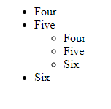
HTML Nested Lists
<ul>
<li> Four </li>
<li> Five
<ul>
<li> Four </li>
<li> Five </li>
<li> Six </li>
</ul>
</li>
<li> Six </li>
</ul>
Output

Slide 30
HTML Table Tags

Slide 31
HTML Tables
HTML tables allow to arrange data into rows and columns. Each table consist on row <tr>, cell <td>, and column <th>
row <tr> </tr>- Table Row
cell <td> </td>- Table Data
column <th> </th>- Table Header
Note:- A table cell can contain all sorts of HTML elements: text, images, lists, links, other tables, etc.
By default, the text in <th> elements are bold and centered.
<caption> Defines a table caption and inserted immediately after the <table> tag.
<colgroup> Specifies a group of one or more columns in a table for formatting <col> Specifies column properties for each column within a <colgroup> element
Other HTML Tags are <thead>, <tbody> <tfoot>

Slide 32
Table Example
<table> <tr> <th>Company</th> <th>Contact</th> <th>Country</th> </tr> <tr> <td>Alfreds Futterkiste</td> <td>Maria Anders</td> <td>Germany</td> </tr> <tr> <td>Centro comercial Moctezuma</td> <td>Francisco Chang</td> <td>Mexico</td> </tr> </table>
Company | Contact | Country
Alfreds Futterkiste | Maria Anders | Germany
Centro comercial Moctezuma | Francisco Chang | Mexico

Slide 33
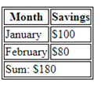
Colspan & NOWRAP attributes
Colspan is an HTML attribute that allows you to span a row or column across multiple cells.
<table>
<tr> <th>Month</th> <th>Savings</th> </tr>
<tr> <td>January</td> <td>$100</td> </tr>
<tr> <td>February</td> <td>$80</td> </tr>
<tr> <td colspan="2">Sum: $180</td> </tr>
</table>
NOWRAP attribute indicates that text should not wrap in the cell.
<TABLE BORDER=1> <TR> <TD NOWRAP> sentence, would prefer not wrap at all any time.</TD> </TR> </TABLE>

Slide 34
HTML Form Tags

Slide 35
HTML Form Element
The HTML <form> element is used to create an HTML form for different types of user input, such as text field, checkboxes, radio buttons, submit button, etc.
<form>
<input>
</form>
The “type” of the input type defined by the ‘type’ attribute.
<input type="text“ value = “Click me”> | Displays a single-line text input field
<input type="radio“ name=“gender” value=“male”> <input type="radio“ name=“gender” value=“female”> | Displays a radio button (for selecting one of many choices)
<input type="checkbox“ name=“hobbies” value=“reading”> | Displays a checkbox (for selecting zero or more of many choices)
<input type="submit“ value=“Submit”> | Displays a submit button (for submitting the form)
<input type=“reset“ value=“Reset”> | Displays a clickable button
<input type=“password” name=“password” placeholder=“ Enter password”>

Slide 36

HTML Form Element
<form> <label for="fname">First name:</label><br> <input type="text" id="fname" name="fname“ value=“Jone” maxlength=“30” ><br> <label for="lname">Last name:</label><br> <input type="text" id="lname" name="lname“ maxlength="30"> </form>
Each input field must have a name attribute to be submitted. If the name attribute is omitted, the value of the input field will not be sent.
The <label> tag defines a label for form elements. The for attribute of the <label> tag should be equal to the id attribute of the <input> element to bind them together. This is because, when the user clicks the text within the <label> element, it toggles the input button/ checkbox.

Slide 37
HTML Form Attributes
action: The action attribute defines the action to be performed when the form is submitted.
<form action="/action_page.php"> </form>
target: The target attribute specifies where to display the response that is received after submitting the form with some static values (_blank, _self, _top, _parent,).
<form action="/action_page.php" target="_blank">
method: The method attribute specifies the HTTP method to be used when submitting the form data. Method can be get or post.
<form action="/action_page.php" method="get">
autocomplete: autocomplete is on, the browser automatically complete values based on values that the user has entered before.
<form action="/action_page.php" autocomplete="on">
novalidate: When present, it specifies that the form-data (input) should not be validated when submitted. <form action="/action_page.php" novalidate>

Slide 38
Form - <input> Tag
input tags are essential elements that allow users to interact with web pages by providing input.
<input> </input>
Type:text – Used to enter Text
<input type="text" id="name" name="name" placeholder="Enter your name" required>
The required attribute specifies that an input field must be filled out before submitting the form.
Type: ppassword – Used to enter Password
<input type="password" name="password" placeholder="Enter your password">
Type: radio – Used to select one option from multiple Options
<input type="radio" id="rating1" name="food-rating" value="1">
<input type="radio" id="rating2" name="food-rating" value=“2">
Type: checkbox – Used to select multiple options
<input type="checkbox" id="music" name="ambiance" value="Music">
Type: file – Used for uploading files
<input type="file" name="fileupload">
Button Type: submit /reset – Used to submit or reset form data

Slide 39
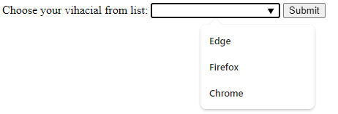
Form - <datalist> Tag
The <datalist> tag specifies a list of pre-defined options for an <input> element. used to provide an "autocomplete" feature for <input> elements. Users will see a drop-down list of pre-defined options as they input data.
<form action="/action_page.php" method="get">
<label for="browser">Choose your browser from the list:</label>
<input list="browsers" name="browser" id="browser">
<datalist id="browsers">
<option value="Edge">
<option value="Firefox">
<option value="Chrome">
</datalist>
<input type="submit">
</form>

Slide 40

Form - <select> & <textarea> Tags
Select Dropdown
The <select> tag is used to create dropdown lists. Options are defined using the <option> tag within the <select> element.
Textarea
The <textarea> tag is used for multiline text input, such as comments or messages. The size of the textarea can be defined using the rows and cols attributes.
<select name="cars">
<option value="volvo">Volvo</option>
<option value="saab">Saab</option>
</select>
<textarea name="comments" rows="4" cols="50" placeholder="Enter your comments"></textarea>

Slide 41
<a> Tag
The <a> or anchor tag defines a hyperlink, which is used to link from one page to another.
<a> Attriutes
href:- The href attribute specifies the link's destination:
download:- Specifies that the target will be downloaded when a user clicks on the hyperlink
<a href="/images/myw3schoolsimage.jpg" download>
target:- Specifies where to open the linked document. The value could be blank (new windows), _self (same frame), _parent (parent frame), _top (use full body of the window)
<a href="https://www.w3schools.com" target="_blank">Visit W3Schools</a>
type: Specifies the media type of the linked document
<a href="https://www.w3schools.com" type="text/html">W3Schools</a>

Slide 42
<nav> Tag
For creating a navigation bar, the commonly used tag is <nav>. OR
The <nav> tag is used to define a navigation section on a webpage.
<nav>
<ul>
<li><a href="#home">Home</a></li>
<li><a href="#about">About</a></li>
<li><a href="#services">Services</a></li>
<li><a href="#contact">Contact</a></li>
</ul>
</nav>
<!-- Rest of your webpage content goes here -->

Slide 43

HTML <nav> Layout
<nav> - Consist on navigation links
<nav style="background-color:#bcdeef;">
<h1 style="text-align: center;">Navgation Links</h1>
<ul>
<li><a href="#">link1</a></li>
<li><a href="#">link2</a></li>
<li><a href="#">link3</a></li>
<li><a href="#">link4</a></li>
</ul>
</nav>
The <nav> tag itself doesn’t have any inherent physical appearance; it’s simply a semantic HTML element that indicates a section of navigation links. You might want to style a <nav> tag to make it visually appealing.

Slide 44
<header> Tag
The <header> tag is typically used to define a header section for a document or a section within a document. It often contains elements such as headings, logos, navigation menus, and other introductory content.
It is commonly found at the top of a webpage and helps in providing information about the document as a whole.
<header>
<h1>Website Title</h1>
<nav>
<ul>
<li><a href="#home">Home</a></li>
<li><a href="#about">About</a></li>
<li><a href="#contact">Contact</a></li>
</ul>
</nav>
</header>

Slide 45
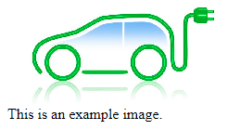
<figure> Tag
The <figure> tag in HTML is used to encapsulate any content that is referenced from the main content, such as images, diagrams, illustrations, videos, and code snippets. It is often paired with the <figcaption> tag to provide a caption for the content within the <figure> element.
<figure> element is used to mark up a photo in a document, and a <figcaption> element is used to define a caption for the photo:
<figure>
<img src="example.jpg" alt="An example image">
<figcaption>This is an example image.</figcaption> </figure>

Slide 46

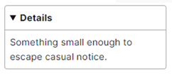
<detail> Tag
The <details> html element creates a disclosure widget in which information is visible only when the widget is toggled into an "open" state. A summary or label must be provided using the summary element.
The default closed state displays only the triangle and the label inside <summary> When the user clicks on the widget, it "twists" open, revealing its contents. You can use CSS to style the disclosure widget, and you can use JavaScript to programmatically open and close the widget by setting/removing its open attribute.
<details>
<summary> Details</summary>
Something small enough to escape casual notice.
</details>
After toggled in open state

Slide 47

<mark> & <dialog>Tags
The <mark> HTML element represents text which is marked or highlighted for reference or notation purposes.
The <dialog> HTML elemet is used to create a dialog box
<dialog open>This is an open dialog window</dialog>
<p>Most <mark>salamander</mark>s are nocturnal, and hunt for insects, worms, and other small creatures.</p>

Slide 48
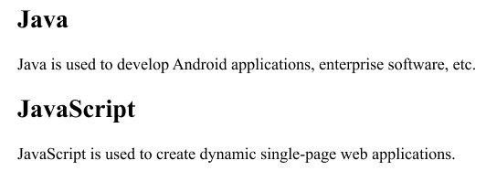
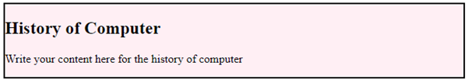
<section> & <article> Tags
<Section> This tag should always have a heading
<section>
<h2>Java</h2>
<p>Java is used to develop Android applications, enterprise software, etc.</p>
</section>
<section>
<h2>JavaScript</h2>
<p>JavaScript is used to create dynamic single-page web applications.</p>
</section>
<article>
<article style="width: 100%; border:2px solid black; background-color: #fff0f5;">
<h2>History of Computer</h2>
<p>Write your content here for the history of computer</p>
</article>

Slide 49
<template> Tag
<template> tag is used to hold some content that will be hidden when the page loads. The content inside <template> can be repeatedly rendered later with a JavaScript.
<template> <h2>Flower</h2> <img src="img_white_flower.jpg" width="214" height="204"> </template>
You can use the <template> tag if you have some HTML code you want to use over and over again, but not until you ask for it.
Notes:
<template> <div class="myClass">I like: </div> </template> <script> let myArr = ["Audi", "BMW", "Ford", "Honda", "Jaguar", "Nissan"]; function showContent() { let temp, item, a, i; temp = document.getElementsByTagName("template")[0]; item = temp.content.querySelector("div"); for (i = 0; i < myArr.length; i++) { a = document.importNode(item, true); a.textContent += myArr[i]; document.body.appendChild(a); } } </script>

Slide 50
<ifram> Tag
An HTML iframe (inline frame) is used to display a web page within a web page or used to embed another document or webpage within the current HTML document.
<iframe src="demo_iframe.htm" height="200" width="300" title="Iframe Example"> </iframe>
sandbox:- The sandbox attribute enables an extra set of restrictions for the content in an iframe like
block form submission
block script execution
disable APIs
prevent links from targeting other browsing contexts
….
<iframe src="demo_iframe.htm" height="200" width="300" title="Iframe Example“ sanddbox> </iframe>

Slide 51
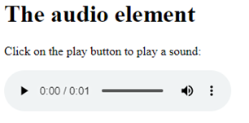
<audio> Tag
The <audio> tag is used to embed sound content in a document, such as music or other audio streams.
<h1>The audio element</h1>
<p>Click on the play button to play a sound:</p>
<audio controls> <source src="horse.ogg" type="audio/ogg"> <source src="horse.mp3" type="audio/mpeg"> Your browser does not support the audio tag. </audio>
The <audio> tag contains one or more <source> tags with different audio sources. The browser will choose the first source it supports.
The text between the <audio> and </audio> tags will only be displayed in browsers that do not support the <audio> element.
There are three supported audio formats in HTML: MP3, WAV, and OGG.

Slide 52
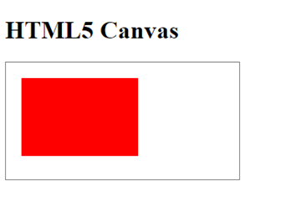
HTML Canvas
The <canvas> element defines a bitmapped area to draw shapes, lines, curves, boxes, text, and images, with colors, rotations, transparencies, and other pixel manipulations.
<canvas id="myCanvas" width="300" height="150"></canvas>
<canvas> element has no drawing abilities, but javascript can be used to draw any graphics.
<!DOCTYPE html>
<html>
<body>
<h1>HTML5 Canvas</h1>
<canvas id="myCanvas" width="300" height="150" style="border:1px solid grey"></canvas>
<script>
const myCanvas = document.getElementById("myCanvas");
const ctx = myCanvas.getContext("2d");
ctx.fillStyle = "red";
ctx.fillRect(20, 20, 150, 100);
</script>
</body>
</html>

Slide 53
Semantic vs Non-Semantic Tags
A semantic element describes its meaning of displaying contents.
<form>, <table>, <footer>, <nav>, <time>
A non-semantic element tells nothing about its contents
<div>, <span>

Slide 54
<meta> Tag
The <meta> tag defines the information about the data to display. It always go inside the <head> element, and are typically used to specify character set, page description, keywords, author of the document, and viewport settings.
Attributes
charset:- Specifies the character encoding for the HTML document.
name:- Specifies a name for the metadata
Define keywords for search engines:
<meta name="keywords" content="HTML, CSS, JavaScript">
Define a description of your web page:
<meta name="description" content="Free Web tutorials for HTML and CSS">
Define the author of a page:
<meta name="author" content="John Doe">
Refresh document every 30 seconds:
<meta http-equiv="refresh" content="30">
Setting the viewport to make your website look good on all devices:
<meta name="viewport" content="width=device-width, initial-scale=1.0">

Slide 55
<base> Tag
The "base" element in HTML is used to specify a default URL and a default target for all links on a page. It is placed within the head section of an HTML document and helps establish a base URL for relative URLs within the document.
<!DOCTYPE html>
<html>
<head>
<base href=https://www.example.com/ target="_blank">
<title>HTML Base Element Example</title>
</head>
<body>
<p><a href="page1.html">Link to Page 1</a></p>
<p><a href="page2.html">Link to Page 2</a></p>
</body>
</html>
For example, you can set the base URL once at the top of your page in header section, then all subsequent relative links will use that URL as a starting point.

Slide 56
Global Attributes
The global attributes are attributes that can be used with all HTML elements. Some global attributes are
class:- Use specifically for style sheet or by a javascript to make changes to HTML element. Class names are case-sensitive.
id:- Define the unique id for an element and used for style or by a javascript to make changes to HTML element. Id name is case-sensitive.
style:- Specifies an inline CSS style for an element
title:- Specifies extra information about an element
hidden:- Browsers should not display elements that have the hidden attribute specified.
lang:- Specifies the language of the element's content
inert:- Specifies that the browser should ignore this section

Slide 57
Class Attribute
HTML Class
<h2 class="logo">Programiz</h2>
<style>
.logo { color: blue; }
</style>
Multiple HTML Elements with same Class
<h2 class="animal">Dog</h2>
<h2 class="animal">Monkey</h2>
<style>
.animal {
color: blue;
}
</style>
Multiple Class in HTML
<h2 class="animal dog">Lily</h2>
<style>
.animal {
color: red;
}
.dog {
border: 1px solid black
}
</style>
Class with JavaScript in HTML
<h2 class="fruit">APPLE</h2>
<script>
let element = document.getElementsByClassName("fruit")[0]
element.innerHTML = "ORANGE"
</script>

Slide 58
ID Attribute
HTML Id
<h2 id="title">Programiz</h2>
<style>
#title {
color: red;
}
</style>
HTML id with JavaScript
<h1 id="heading">Main Heading</h1>
<script>
let element = document.getElementById("heading");
element.innerHTML = "Content"
</script>
HTML id for Anchor links
<h1 id="heading">Main Heading</h1>
<p class="main-content">
This is a paragraph
</p>
<a href="#heading">Go to the top</a>
<a href="programiz.com/html/head#title-tag"> Link </a>
clicking on the Go to top will scroll the page to the h1 tag with the id "heading“
clicking on this link will take us to the URL programiz.com/html/head and
then scroll to the element with the id title-tag.

Slide 59
HTML Events
HTML has the ability to create an action on events trigger in a browser.
Developer can write the action in JavaScript based on event trigger. These events can be categories in
Form Events – onsubmit / onselect / onchange / onreset / oninput ….
Keyboard Events – onkeydown / onkeypress / onkeyup
Mouse Events – onclick / ondblclick / onmouseover / onmousemove ….
Drag Events – ondrag / ondragleave / onscroll / ondrop …..
Clipboard Events – oncopy / oncut / onpaste
Media Events – oncanplay / onerror / onloadstart / onpuse …..

Slide 60
Inline & Block-level Elements
HTML elements can be categorized into one of two categories
Inline Elements:-
These elements take space according to their contents require.
Do not start on a new line.
Examples:- <a> / <br> / <img> / <input> / <input> / <label> / <spam> …
Block-level Elements:-
Block level elements take up as much space as possible by default.
Always starts on a new line.
Examples:- <p> / <div> / <hr> / <li> / <ol> / <ul> / <h1> -- <h6> / <table> …
Note:- Inline elements cannot contain block level elements

Slide 61
HTML Inline & Block Elements
CSS properties height and width have no effect on inline elements.
<p> The following span is an <span style="border: 1px solid black">Inline Element.</span></p>
<style>
span { height: 200px; /* No Effect on Element */
width: 200px; /* No Effect on Element */ }
</style>
Inline elements also do not have top and bottom margins, they only respect left and right margin.
<div><span>1</span><span>2</span></div>
<div><span>3</span><span>4</span></div>
<style>
span {
margin-top: 10px;
margin-bottom: 10px;
margin-left: 10px;
margin-right: 10px;
border: 1px solid black;
}
</style>

Slide 62
HTML Inline & Block Elements
Inline elements respect padding in all directions.
Block elements respect height and width properties. We can change both height and width of block elements using CSS.
Block elements take up the whole width of the parent container even if we set their width to a smaller size. Hence we cannot have a block element with another element in the same line without CSS. For example,
<p style="width: 20px; border: 1px solid black;background-color: lightblue">1</p>
<p style="width: 20px; border: 1px solid black; background-color: lightblue">2</p>

Slide 63
HTML Layout
Layout decide the structure for visual elements of an page. Here we discuss elements used for different parts of a webpage.
<header>: It is used to define a header for a document or a section.
<nav>: It is used to define a container for navigation links
<section>: It represent a separate section of a web page which contains related element grouped together. It can contain: text, images, tables, videos, etc. We can have a <section> inside a <section> tag.
<article>: It is used to define an independent self-contained article such as big story, huge article, etc.
<aside>: It is used to define content aside from the content (like a sidebar). The <aside> content must be related to the primary content.
<footer>: It is used to define a footer for a document or a section
<details>: It is used to define additional details
<summary>: It is used to define a heading for the <details> element

Slide 64
Responsive Image
To create the responsive page, width property should be 100%
<img src="img_girl.jpg" style="width:100%;">
This will create full screen image, possibly the image can be scaled up to be larger than its original size. A better solution in many cases, use the max-width property.
<img src="img_girl.jpg" style="max-width:100%;height:auto;">
<picture> - The <picture> element allows you to specify multiple <source> elements, each of which can have its own media query.
<picture>
<source srcset="logo_small.png" media="(max-width: 400px)">
<source srcset="logo_regular.png">
<img src="logo_regular.png" alt="Logo">
</picture>

Slide 65
Responsive Text
To create a responsive text, we use “vw” unit for this purpose.
<h1 style="font-size:10vw">Hi everyone!</h1>
10vw stands for 10% of the viewport’s width regardless of the device size.

Slide 66
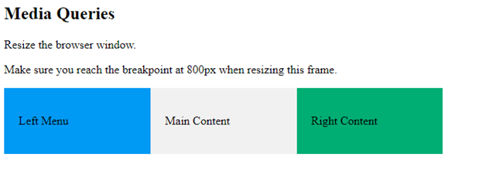
Media Queries
Media query is a CSS technique that defines completely different styles for different browser sizes.
/* Use a media query to add a break point at 800px: */
@media screen and (max-width: 800px) {
.left, .main, .right {
width: 30%; /* The width is 30%, when the viewport is 800px or smaller */
}
}

Slide 67
Using IDs and Classes in CSS
In CSS, elements with IDs are selected using a hash (#) symbol before the ID, and elements with classes are selected using a dot (.) before the class name.
/* CSS for ID */
#myUniqueID { background-color: yellow; }
/* CSS for Class */
.myClass { font-size: 18px; }

Slide 68
HTML Styling
HTML (Hypertext Markup Language) was responsible for both defining the structure and content of a web page and controlling its presentation and layout in limited manner. HTML styling is define within the HTML tags themselves. For example
<font> tag is used to specify text color, size, and face directly within the HTML document.
<font color="blue" size="4" face="Arial">This is blue, size 4, Arial font.</font>
“align” attribute is used to control the alignment of elements like images, tables, and text.
<p align="center">This paragraph is centered.</p> <img src="image.jpg" alt="An example image" align="left">

Slide 69
Inline Styling
Inline styles allow developers to apply styling directly within individual HTML elements, offering a quick and straightforward way to achieve a specific presentation for a particular element.
The syntax for inline styles involves using the style attribute within an HTML tag. Here are some examples
<p style="property: value;">This is a paragraph with an inline style.</p>
<div style="background-color: #ffeecc;">This div has a custom background color.</div>
<div style="border: 1px solid #333; padding: 10px;">This div has a border and padding.</div>
<span style="font-family: 'Arial', sans-serif;">This text has a custom font family.</span>

Slide 70
Pros and Cons of Inline Styles
Pros:
Immediate Impact: immediately visible in the browser
Specificity: allowing to override external or internal styles
Local Scope: locally to the specific element
Cons:
Limited Reusability: Styles are applied on a per-element basis.
Maintenance Challenges: Individual Updates and modifications require.
Less Readable HTML: Can make the HTML code less readable.

